Slide 1
Update on the Wisconsin Economy
Noah Williams
April 15, 2020

Slide 2
Economic Impact of COVID-19
Regular updates posted on our webpage: https://crowe.wisc.edu/impact-of-covid19/
Topics to discuss today:
Labor Market and Unemployment
Economic Activity
Household Consumption and Retail Sales
Airlines and Transportation
China’s Experience
Initial Data on PPP

Slide 3
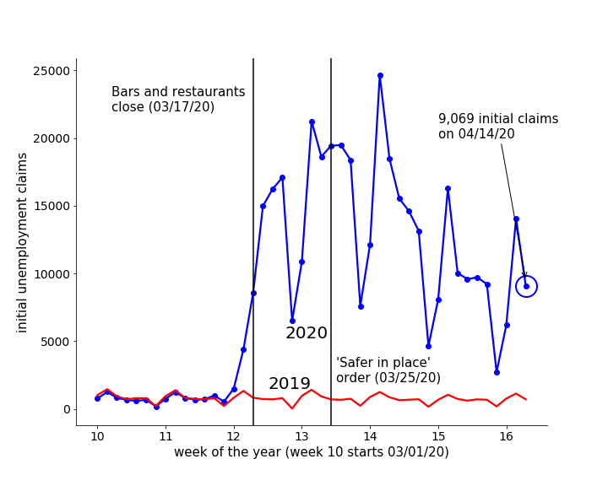
Initial Unemployment Claims

Slide 4
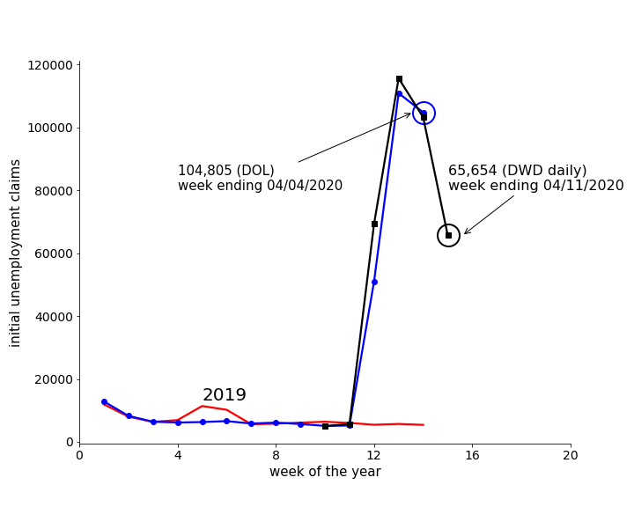
Initial Unemployment Claims

Slide 5
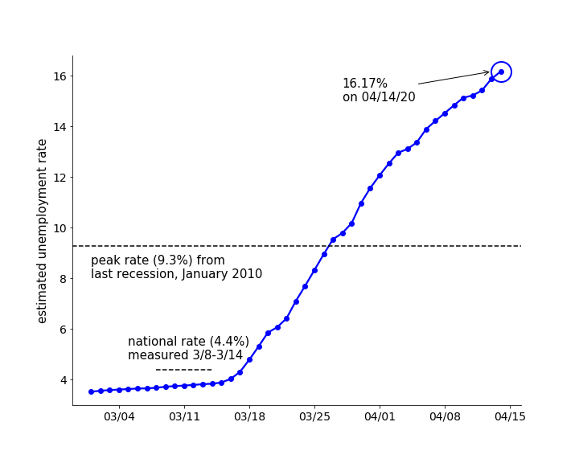
Estimated Unemployment Rate

Slide 6
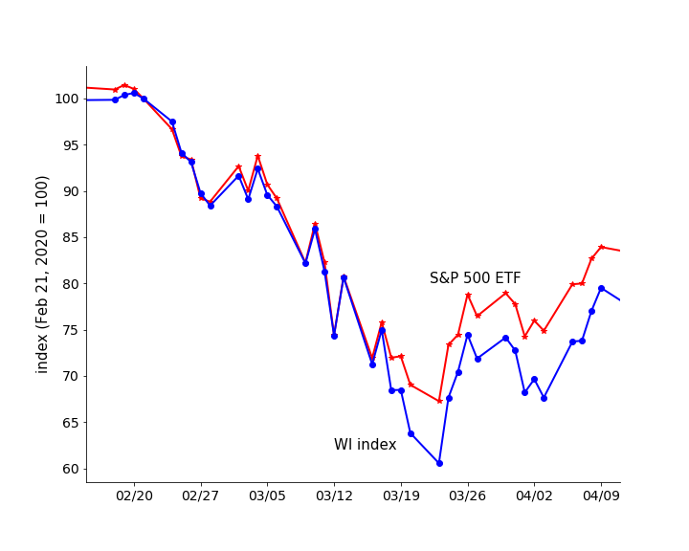
Value of Public Companies

Slide 7
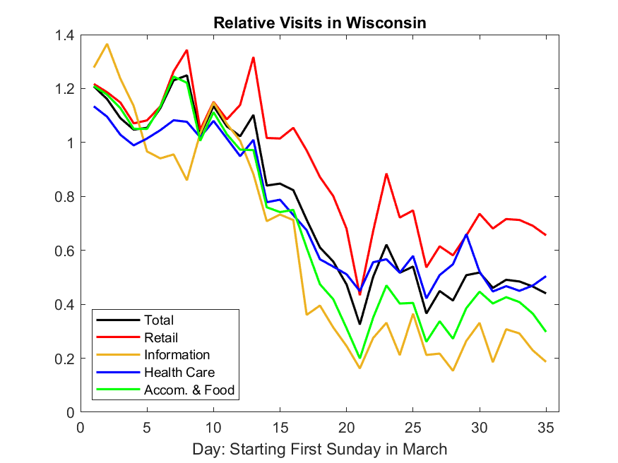
Economic Activity: Foot Traffic
Source: SafeGraph

Slide 8
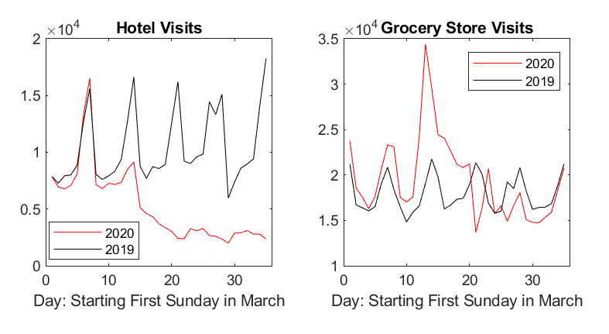
Economic Activity: Foot Traffic
Source: SafeGraph

Slide 9
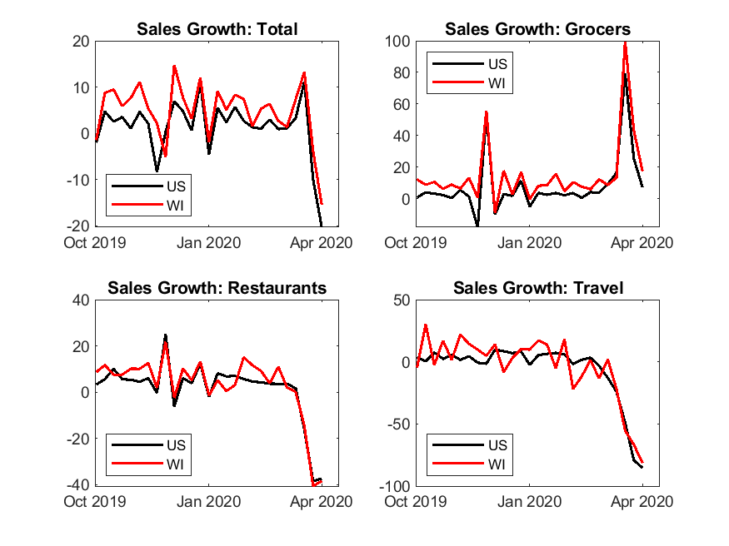
Household Consumption Patterns
Source: Earnest Research

Slide 10
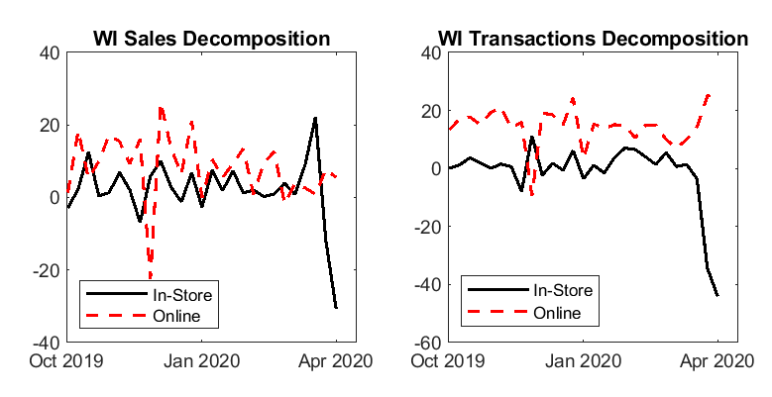
Household Consumption Patterns
Source: Earnest Research

Slide 11
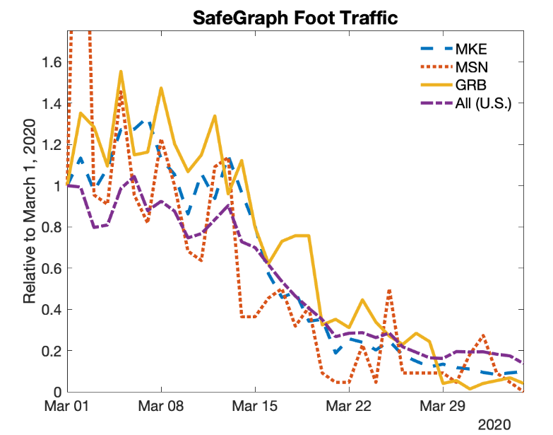
Airline Passenger Traffic
Source: SafeGraph

Slide 12
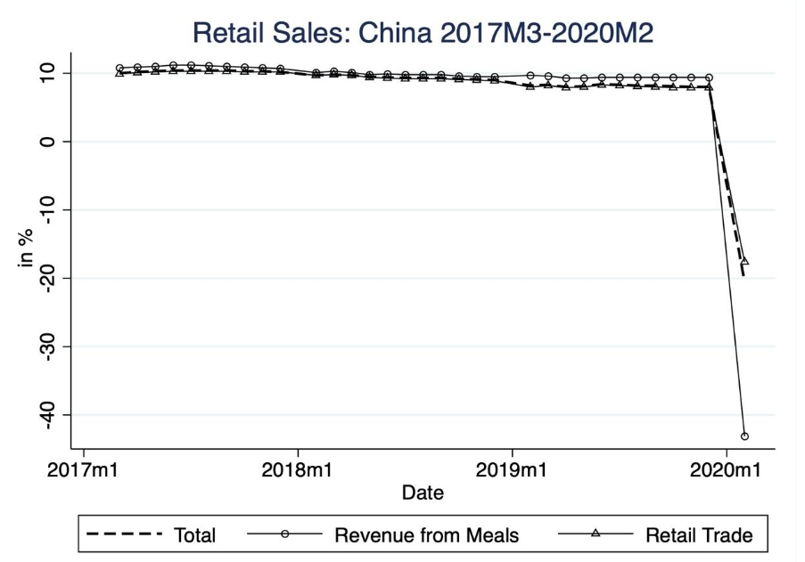
China’s Decline

Slide 13
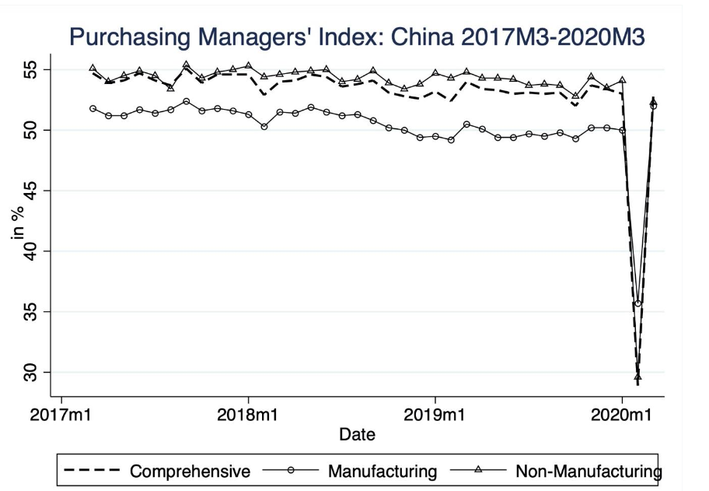
China’s Recovery

Slide 14
Initial Data on PPP
Paycheck Protection Program: $350 billion allocated through SBA for <500 employees. 8 weeks of expenses, forgivable if 75% payroll
As of Tuesday: $268B approved nationwide to 1.2 million applicants
As of Monday: 31,702 loans in Wisconsin approved, totaling $7.28B
For comparison, size of Wisconsin small business sector from 2017 data
Sector | Share of Firms | Share of Employment | Payroll
TOTAL | 97% | 50% | $50.3B
Retail | 96% | 40% | $3.7B
Food & accommodations | 98% | 69% | $2.5B

